Slide 1
The code of life
UniStem day 2020

Slide 3
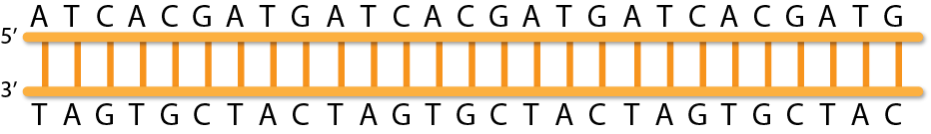
The human genome
3,234,830,000 bases (A/T/G/C)
> 50,000 genes
> 200,000 transcripts
Hidrogen
bonds
Base pairs
(nucleotides)
Backbone
Notes:
Basic structure of DNA
Nanopore slide/video

Slide 4
Sequencing machines Nanopore

Slide 5

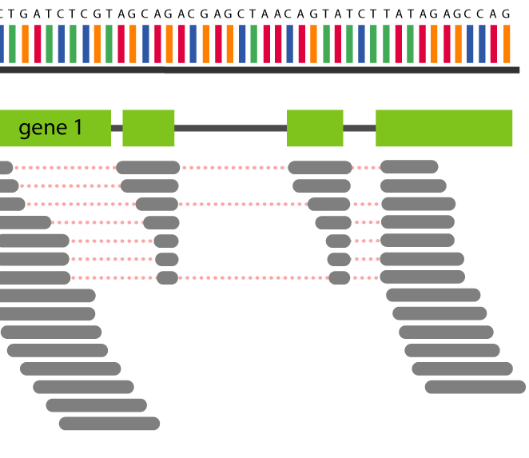
How do you find changes in a 3,234,830,000 bp long sequence?
Traditional genetics:
Study one gene at the time
Modern genetics:
Study all genes at once
To get the DNA sequence from the samples..
Notes:
10 intro
15 exercise
10 scRNA
5 discussion
Summary description for paulina
Put jupyter on github and db.fna
Nanopore?

Slide 6

Bioinformatics
Computer
science
Biology
Statistics

Slide 7
Transcriptional and gene regulation
Genome
Transcription
Post-transcriptional gene regulation
RNA
Bioinformatics
Translation
Protein and signaling networks
Proteins
Modification
Metabolic networks
Dynamics

Slide 8
Bioinformatics in the UniStem center
*A bunch of pictures from different experiments?*

Slide 9
Our work
Input: A bunch of reads
Programming languages
Python, R, perl, Java, C, C++, C#...
Why python?

Slide 10
Intro to python variables
A variable is a named memory space. There are different types of them
foo = “Hello”
num = 100
var = True

Slide 11
Intro to python functions
A function is a set of instructions to execute (usually given a variable)
print( ) # Print is a function
foo
> Hello
You can also concatenate things before printing
print(foo + “ - ” + )
Length of “hello”
str( )
len(foo)
> Hello - 5

Slide 12
Intro to python conditions
How to compare two values or variables
foo2 = “Hello world”
if(foo == foo2){
print(“Same”)
}
else{
print(“Not the same”)
}
> “Not the same”
if(foo in foo2){
print(“Foo in foo2”)
}
> “Foo in foo2”

Slide 13
Intro to python loops
From zero to the length of the variable “string”:
print( )
range( )
(len(foo))
From 0 to the length of foo
A loop is a block of code that is going to be repeated
for i in range(len(foo)):
print( )
character
foo
str(i) + “: ” + foo[i]
character
> 0: H
> 1: e
> 2: l
> 3: l
> 4: o
Notes:
output of range

Slide 14
Exercise
Your stem cell research colleagues are struggling in the lab: a lot of their cells are dying and they seem to be a in a bad shape, infection?
One of your molecular biologist colleagues has been able to isolate the culprit and do DNA sequencing on it.
You, as the bioinformatician in the group is given the task to analyse the sequence and try to figure out what the heck it is! Together with your PI you decide to identify some basic statistics of the sequence.

Slide 15
GC content
GC content is the percentage of a sequence that is made out of Guanines (G) and Cytosines (C).
It is a quick of comparing genomes.
Given the sequence of the patogen that is causing problems in the lab (pretend this is way longer), calculate the GC content!
Notes:
Basic structure of DNA

Slide 16
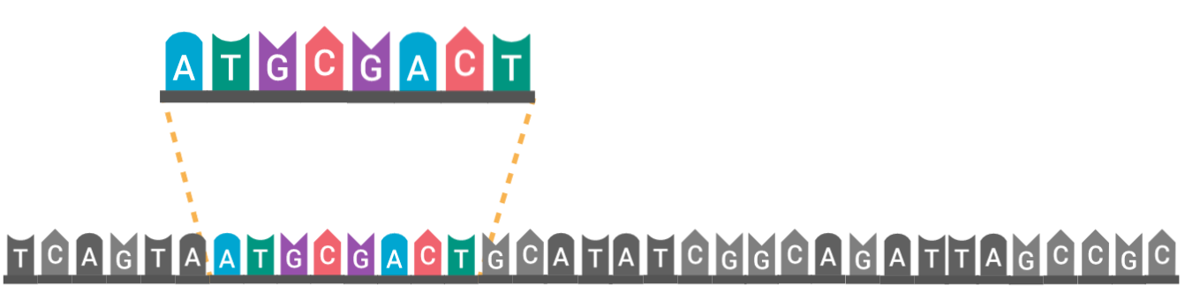

Motif find
A collegue of yours was sick last week and went to the lab anyway... Your PI is concerned that the cells were in contact with him and catched a virus.
He asks you to check if you can find the following sequence in the data
Motif
Notes:
Basic structure of DNA

Slide 17

K-mers
What if I change one single basepair? Just one little mutation in the last basepair.
How would you know if it's a hit?
Motif
Notes:
Basic structure of DNA

Slide 18
K-mers
What if I change one single basepair? Just one little mutation in the first basepair.
How would you know if it's a hit?
K-mer
K-mer
K-mer
K-mer
K-mer
Motif
Notes:
Basic structure of DNA

Slide 19
BLAST

Slide 20
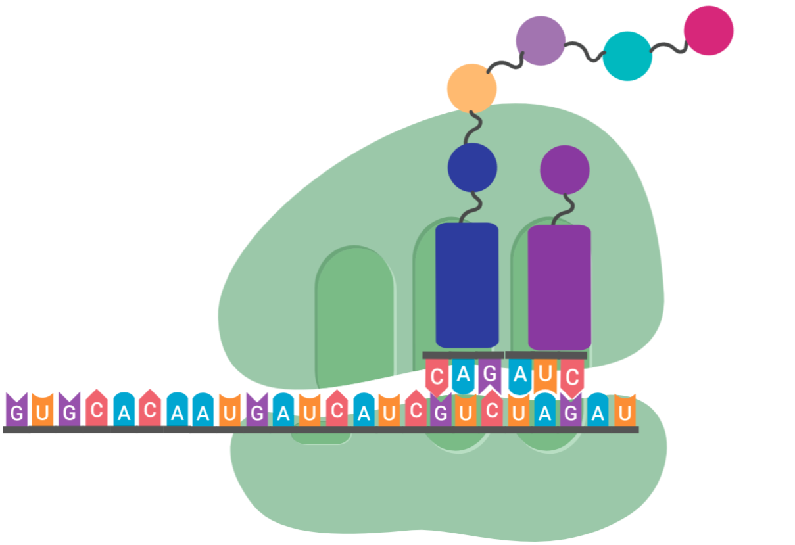
Extra exercise
Translate the sequence to protein
Q
I

Slide 21
Intro to python dictionaries
A dictionary relates two values with each other
dict = {
“brand” : “Ford”,
”model” : “Mustang”,
“year” : 1964
}
print(dict[“model”])
> Mustang

